Slide 1
SPRING 2026 | BFOR643 – INCIDENT HANDLING (6136)
Host-Based Forensics &
Timeline Reconstruction
Using Plaso + Timesketch
Instructor: Dr. Vinicius Lima
Nicholas Tsilimidos, Craig Perkins, Shreyak Karmacharya & Ikram Ramdani

Slide 2
PROJECT OVERVIEW
The Core Idea
This project focuses on host-based forensic analysis and timeline reconstruction using the Digital Corpora 2009 M57 Patent Scenario dataset. The objective is to analyze a forensic disk image and reconstruct system activity by extracting timestamped artifacts from the system.
Using Plaso (log2timeline), we process the disk image to generate a detailed timeline of events, including file system metadata, Windows event logs, and registry activity. These artifacts are then used to identify patterns of behavior and potential indicators of compromise.
The generated timeline can be further visualized and analyzed using Timesketch, allowing investigators to correlate events and reconstruct how activity occurred on the system. This approach supports the incident response process by helping determine the scope of an incident and providing evidence-based conclusions.
Extract
Correlate
Visualize
Pull every timestamped artifact from a disk image, without altering the evidence
Combine events from multiple sources into one unified chronological timeline
Search, tag, annotate, and present the timeline to investigators and courts
Plaso does this
Plaso + CSV
Timesketch does this

Slide 3
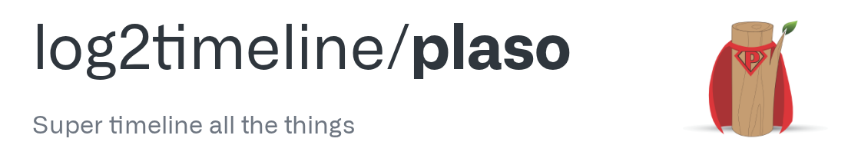
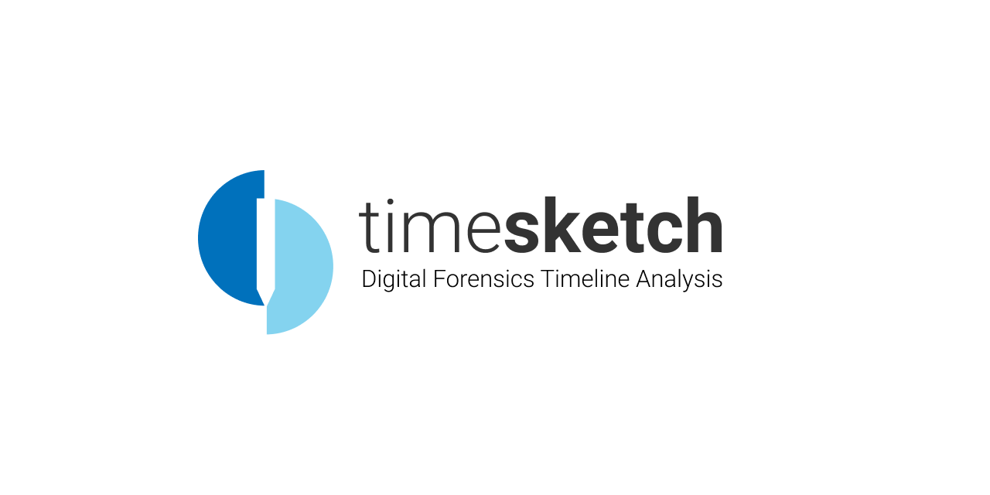
TOOL DEEP DIVE
Selected Tools
log2timeline/plaso
It is a python-based open source tool.
It extracts and normalizes timestamps from across hundreds of forensics artifact types into a single .plaso storage file.
Key features includes
800+ parsers which process windows registry, event logs, browser history, macOS artifacts, linux logs etc.
Timesketch
It is an open source tool that formulates a forensics timeline analysis.
It utilizes the .plaso file that contains our dataset and provides a web based interface that allows investigators to easily share, annotate or tag and visualize the forensic event. This helps forensics and incident response teams collaborate much easily.
Key features:
Powerful search tool that’s able to hunt through millions of events and save searches that you want to highlight to your team
you can edit events and customize the labels (ex: 'exfiltration'), there are built in charts that can spot spikes in activity that may help analysts correlate events across multiple data sources.
Fun fact - timesketch can even spot attack patterns and TTPs aligned with the MITRE ATT&CK framework

Slide 4
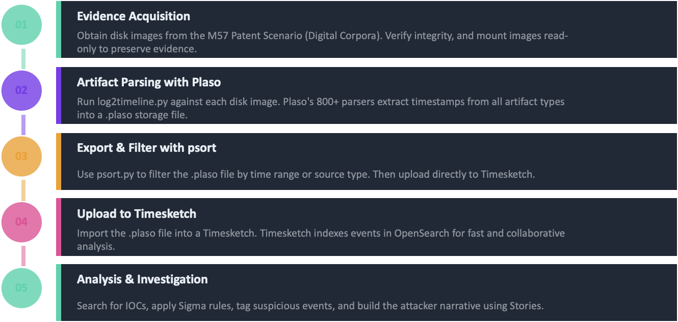
METHODOLOGY
How We Ran the Investigation

Slide 5
METHODOLOGY - TECHNICAL
Why This Matters to Incident Response
Attack Timeline Reconstruction
Chronologizes events that occurred
When did the attacker gain initial access
When did the attacker conduct lateral movement
When did the attacker exfiltrate data
Attack Timeline Reconstruction
Chronologizes Attacker Behavior
Tag process executions
Filters for unusual file access
Searches for suspicious logons
Digital Forensics and Incident Response
Maintain Data Integrity
Correlate disparate data sources
Preserve timestamps and metadata
Determine if the attacker is currently active

Slide 6
INVESTIGATION FINDINGS
What the Timeline Revealed
SUSPECT IDENTIFIED:
Jo Smith - Patent Researcher (jo@m57.biz)
Source: Corporate files found in bulk copies across jo's machine and jo's work usb
Who?
What?
Jo Smith confirmed as sole active user via Windows registry HKEY_CURRENT_USER, user profile path C:\Documents and Settings\Jo\, and prefetch artifacts, all parsed by Plaso
4,812 proprietary patent research PDFs. M57's client deliverables. Named [ID].[Topic].[Author].pdf. Same 282-paper set duplicated 17 times on Dec 10, day before seizure
How?
Cover-up?
Two-stage USB exfiltration: Nov 20 (18 files copied to XFER folder) + Dec 10 (4,794 files in Papers1 to Papers17). Personal Hotmail webmail used outside company monitoring
Outlook Express run 14 times on Dec 11 (police day). Inbox.dbx modified Dec 9 per USNJRNL. Hotmail bypassed company email logging entirely

Slide 7
INDICATORS OF COMPROMISE
Forensic Evidence Timeline
Nov 20
First Transfer + Webmail
18 patent PDFs -> XFER-11-20-2010 folder on work USB | Hotmail accessed
Nov 23
Tooling Installed
Python 2.6 + email libraries installed on work machine | Email shortcut created on desktop
Nov 25
Webmail Again
Hotmail accessed a second time | Possible communication with outside contact
Dec 09
Email Activity
Inbox.dbx modified | Active email exchange 2 days before police arrival
Dec 10
Bulk Exfiltration
4,794 files across Papers1 to Papers17 copied to work USB | Day before seizure
Dec 11
Police Arrive - Cover-up
Outlook Express opened 14 times | Consistent with deleting sent emails

Slide 8
CHALLENGES & LESSONS LEARNED
What We Learned Along the Way
Setup & Environment
Working With the Data
Running plaso on an apple machine is not recommended, we switched to a Kali Linux VM and it was much smoother.
Setting up Timesketch was even harder so, we moved to Windows and it just worked.
The CSV timelines are massive so, we recommend using python filtering and Timesketch search to analyze it.
Timestamps can be deliberately faked by an attacker (timestomping), always worth keeping that in mind.
Processing & Performance
Tool Limitations
Plaso take a lot of time to extract artifacts, running extractions in parallel across terminals makes a lot of difference.
Make sure to watch out for your system resources and how much you are using it. Docker shows everything in real time.
Plaso can't read actual email content, only the metadata around it. That was a real gap in this investigation.
Timesketch on its own does not create the full picture, you need network and memory forensics alongside it

Slide 9
COURT DEFENSIBILITY
What This Evidence Can and Can't Do
One of the most important questions in digital forensics is: can this evidence be trusted in court?
What We Established
What Strengthens the Case
What's Still Missing
Plaso & Timesketch fall in Detection & Analysis phase of IR
Processed files in read-only mode, original evidence never touched
Files went to USB but can't prove where they went after
Disk artifacts alone gave us: who, what, how, and when
Fully documented, same commands, same result, every time
Outside contact could not be identified from disk image alone
Every finding ties to a specific artifact and timestamp
Same event on Jo's machine and his work USB, moreover multiple copies
Timeline shows activity, cannot prove intent
Bottom line:
Host forensics tells you what happened on the machine. Network forensics tells you where the data went and who it went to. Memory forensics tells you what was running at the time that never got written to disk. You need all three to build a complete picture.

Slide 10
CONCLUSION
Key Takeaways
Host forensics is the starting point.
When we started this project, we had a disk image, two tools, and a scenario. By the end of it, we had a suspect, a timeline, and a story that the evidence told itself. That's what host-based forensics actually is.
Every artifact left behind by the suspect became a data point, and Plaso and Timesketch gave us the ability to connect those dots across 8 different sources at once.
The tools work. They are not perfect, we ran into limitations, and there are questions this investigation couldn't answer. But the foundation is solid. And in a real incident, that foundation is what everything else gets built on.

Slide 11
Thank You
Nicholas Tsilimidos | Craig Perkins | Shreyak Karmacharya | Ikram Ramdani
Any Questions?

